Slide 1


Tybee Island Tourism study
Prepared by
Center for Business Analytics and Economic Research &
EDA University Center Program
Georgia Southern University

Slide 2
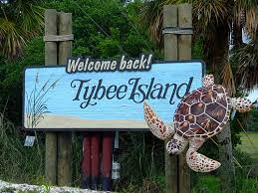
Introduction
Update data reported in the 2015 Tybee Island Tourism Study
Examine various aspects of the tourism economy
Estimate the economic and fiscal impact of Tybee Island visitors
https://roadtips.typepad.com/.a/6a00d8341cad8253ef011570d3062d970c-popup

Slide 3
Survey of Tybee island visitors

Slide 4
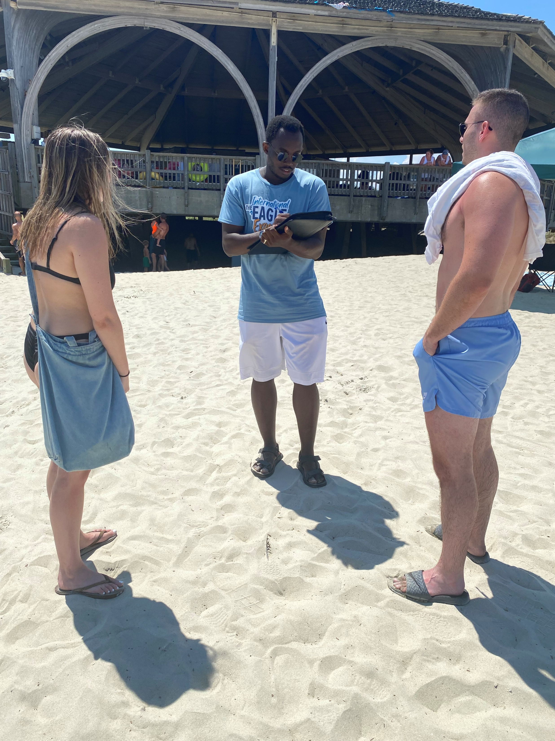
Survey: Basics
4,541 Total Individual Responses
  Online Surveys: 3,202
  In-Person Surveys: 1,338
July 2021 – September 2022
Visitor Survey Analysis
  Point of Origin
  Demographics
  Travel Details
  Visit Frequency & Length of Stay
  Accommodations and Room Nights
  Visitor Satisfaction
Visitor Expenditures

Slide 5
Typical Tybee Island Visitor
Traveled to Tybee Island by personal vehicle (84.3%)
Traveling with other people (95.3%)
Non-Georgia resident (61.2%)
Aged 35 to 64 (69%)
Married/Long-term relationship (77.2%)
Household income of more than $100,000 (58.4%)

Slide 6
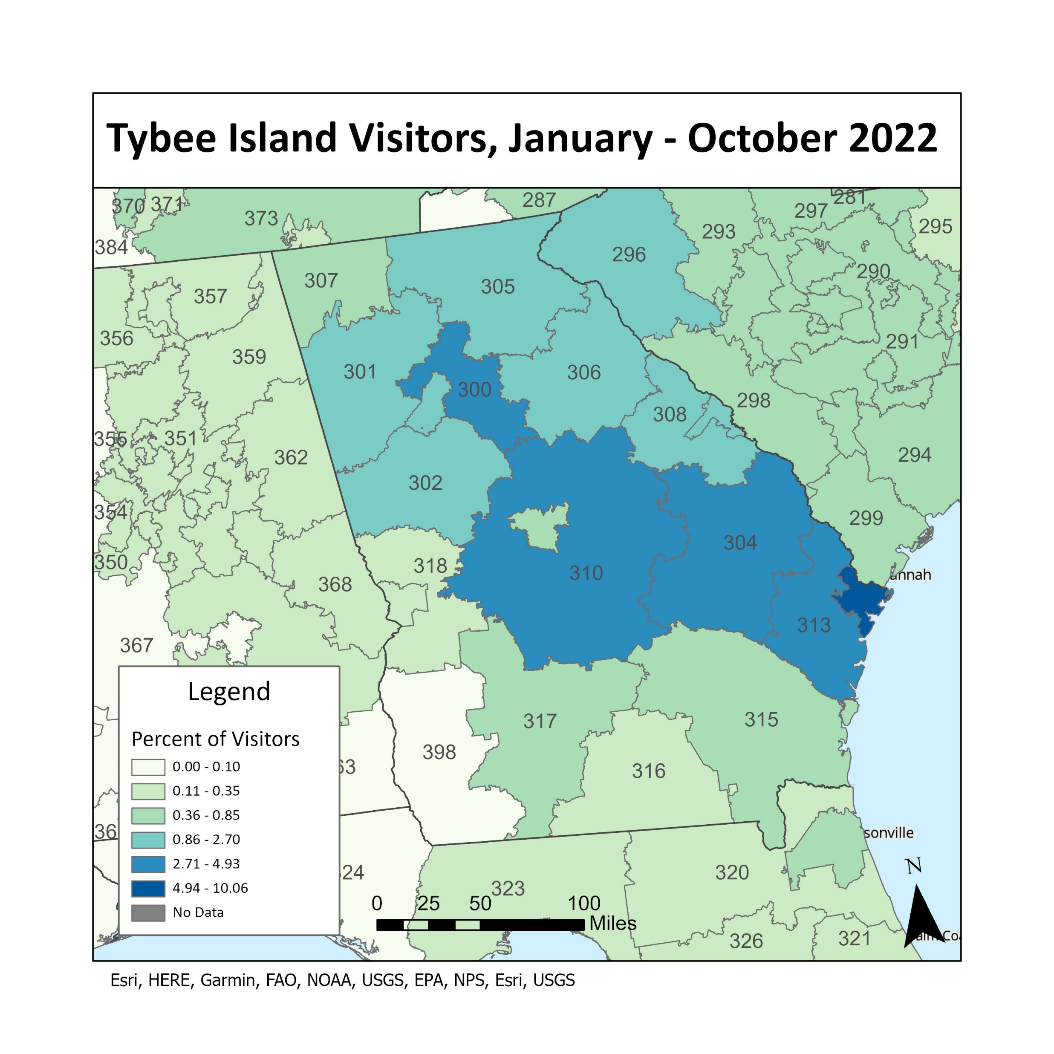
Point of Origin
Visitor Point of Origin Top 10 States 2021-2022
CBAER Survey Data |  |  |  | Placer Data
 | State | % of Visitors |  |  | State | % of Visitors
1 | Georgia | 38.8 |  | 1 | Georgia | 41.6
2 | North Carolina | 7.3 |  | 2 | North Carolina | 6.2
3 | South Carolina | 7.0 |  | 3 | South Carolina | 5.8
4 | Tennessee | 6.3 |  | 4 | Florida | 5.1
5 | Ohio | 5.2 |  | 5 | Tennessee | 4.5
6 | Kentucky | 2.8 |  | 6 | Ohio | 3.9
7 | Virginia | 2.8 |  | 7 | Kentucky | 2.7
8 | Indiana | 2.8 |  | 8 | Virginia | 2.6
9 | Florida | 2.6 |  | 9 | Alabama | 2.3
10 | New York | 2.5 |  | 10 | Illinois | 2.2
*International Visitors from CBAER data accounted for 0.4% of survey participants.

Slide 7
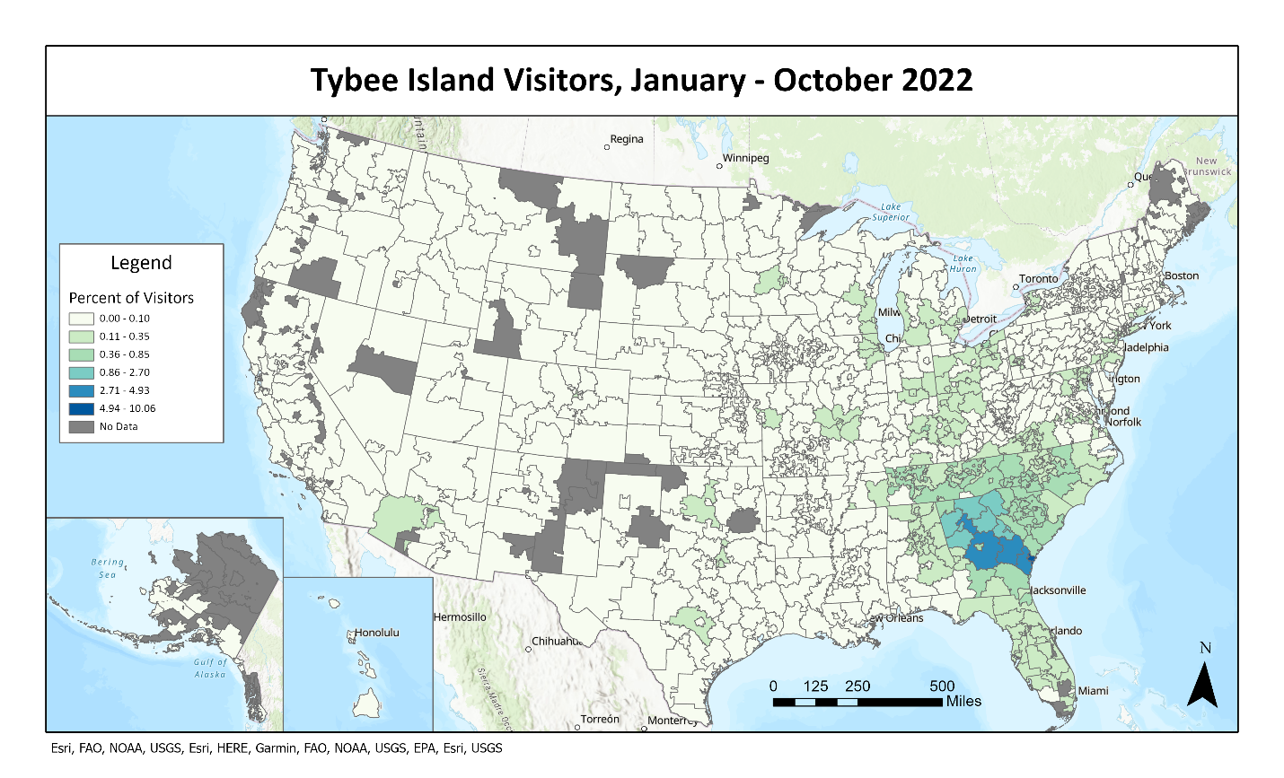
3 Geographic Regions: Chatham County (excluding Tybee Island); Georgia (excluding Chatham County); Out-of-state

Slide 8
Point of Origin Groupings

Slide 9
Demographics: Age

Slide 10
Demographics: Household Income

Slide 11
Demographics: Relationship Status

Slide 12
Travel Details
Type of Travel
  98% of all Georgians drove a personal vehicle
  81% out-of-state visitors drove a person vehicle; 11% flew into the Savannah-Hilton Head International airport
Type of Visit
  39% Tybee overnight visitors
  61% day visitors
  Based on in-person data
Party Details
  Average party size: 4.3
  Mode party size: 2
  73.5% traveled in a group of 2-5 people
  38.1% traveled with children

Slide 13
Visit Frequency and Length of Stay
Annual Visit Frequency
  All visitors
    3.38 annual visits: CBAER data
    3.21 annual visits: Placer.ai data
  Tourists (outside 50-mile radius)
    2.00 annual visits: CBAER data
    1.03 annual visits: Placer.ai data
Long-Term Visitors (stayed more than 14 nights)
  5.1% Tybee overnighters (186)
  2.9% Savannah overnighters (16)
Length of Stay
  Tybee Overnight Visitors
    30.4% stayed 3-4 days; 49% stayed 5+ days
    Average number of nights: 4.5
  Day Visitors
    Includes day visitors and Savannah overnighters
    Most common length of stay: 3 to 5 hours

Slide 14
Accommodations and Room Nights
Tybee Island Overnighters
  Average room nights: 6.7
  Total room nights: 1,188,160
Savannah Overnighters
  Average room nights: 4.0
  Total room nights: 858,131
Tybee Island Overnight Visitors Type of Accommodation
 | % Total Participants | % In-Person Participants
Vacation Rental | 79.5 | 51.0
Hotel / Motel / Resort | 14.0 | 32.8
Private Home / Staying with Friends or Family | 2.9 | 6.7
Historic Inn / Bed & Breakfast | 2.1 | 3.8
Campground / RV Park | 0.9 | 5.2
Other | 0.6 | 0.6
Savannah Overnight Visitors Accommodation Location
Historic District | 62.8%
Staying with Friends or Family | 8.8
Suburban area | 5.5
Pooler area | 4.0
Near the airport area | 1.9
Richmond Hill area | 1.7
Garden City / Port Wentworth area | 1.5
Near Interstate 95 | 1.3
Other | 9.5
Unsure | 2.9

Slide 15
Visitor Satisfaction

Slide 16
Tourist Spending on Tybee Island
Tourist (outside 50-mile radius) Average Daily Spending Per Person on Tybee Island
 | Tybee Overnight Visitors | Savannah Overnight Visitors | Day Visitors
Restaurants | $41.17 | $8.39 | $25.50
Groceries | $13.95 | $1.06 | $2.89
Recreational/Rental Equipment | $6.97 | $0.51 | $1.75
Tours/Attractions | $5.81 | $2.09 | $1.44
Entertainment, Nightlife | $16.55 | $3.12 | $7.11
Shopping | $15.52 | $3.23 | $12.19
Local Transportation | $0.77 | $0.38 | $0.41
Parking | $2.34 | $1.04 | $5.38
Other | $3.38 | $0.66 | $2.65
TOTAL | $106.46 | $20.49 | $59.31
IMPLAN Inputs/Parameters
2021-2022 year
1.7 million annual tourists
1.03 annual visits per tourist
Type of visitor with tourist parameter
  44% Tybee Overnight Visitors
  39% Savannah Overnight Visitors
  17% Day Visitors

Slide 17
Economic Impact of tourist Spending

Slide 18
Total Economic Impact
 | Output* | Value Added* | Labor Income | Employment
Direct | $528.42 | $317.76 | $229.66 | 6,172
Indirect | 154.51 | 77.60 | 47.45 | 955
Induced | 144.61 | 86.71 | 46.81 | 892
Total | 827.54 | 482.06 | 323.92 | 8,018
* Dollars in millions + Impact reported in 2022 dollars.

Slide 19
On-Island (City of Tybee Island) Total Economic Impact
 | Output* | Value Added* | Labor Income | Employment
Direct | $137.39 | $82.62 | $59.71 | 1,464
Indirect | $40.17 | $20.17 | $12.34 | 227
Induced | $37.60 | $22.54 | $12.17 | 211
Total | $215.16 | $125.34 | $84.22 | 1,902
* Dollars in millions + Impact reported in 2022 dollars.

Slide 20
Off-Island (Chatham County) Total Economic Impact
 | Output* | Value Added* | Labor Income | Employment
Direct | $391.03 | $235.14 | $169.95 | 4,752
Indirect | $114.34 | $57.42 | $35.12 | 736
Induced | $107.01 | $64.16 | $34.64 | 687
Total | $612.38 | $356.72 | $239.70 | 6,174
* Dollars in millions + Impact reported in 2022 dollars.

Slide 21
Tax Collections Linked to Visitor Spending
 | Sales Taxes | Property Taxes | Total Lodging Tax
City of Tybee Island | $1,327,000 | $1,838,000 | $8,461,000
Chatham County | $2,084,000 | $3,555,000 | -
+ Impact reported in 2022 dollars.

Slide 22
Comparison of 2015 and 2023 Reports
Visitation and Accommodations | 2023 | 2015
Number of Visitors | 1,763,400 | 1,044,100
Average Overnight Visitor Party Size | 4.50 | 3.75
Average party size | 4.30 | 4.30
Out-of-State Visitor Percentage | 61% | 27%
From Georgia (excluding Chatham County) | 33% | 48%
Economic Impacts | 2023 | 2015
On-island total business revenue (Output) | $215,159,543 | $164,898,510*
Off-island total business revenue (Output) | $612,347,162 | $143,547,000*
On-island total employment | 1,902 | 1,225
Off-island total employment | 6,147 | 1,643
*Inflation adjusted from 2015 to 2022 using CPI

Slide 23
Fiscal Impact analysis

Slide 24
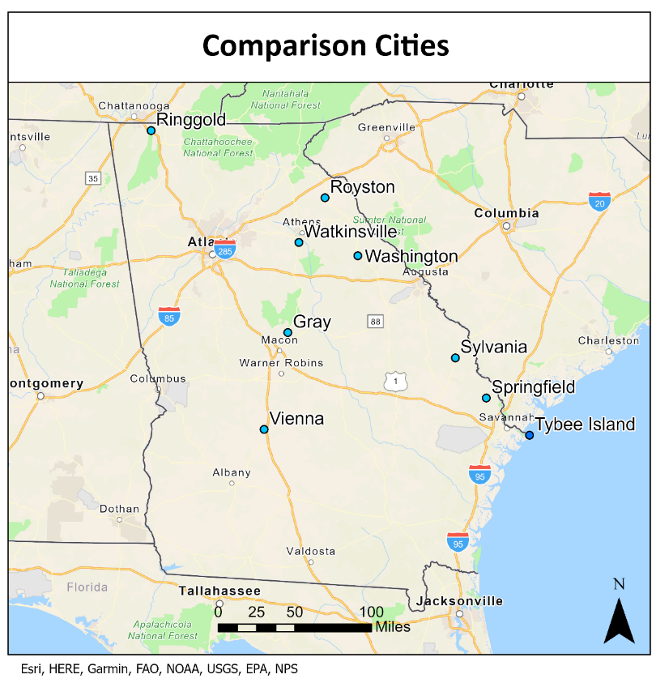
Comparison Group
Demographic and Economic Variables
  Population
  Person/Mile
  Ethnicity Rates (% of White, Black, Hispanic)
  Median Age of Population
  # of Year-Round Residents
  % Occupied Units
  People per Household
  % Units built since 2000
  Median Household Income
  Unemployment Rate

Slide 25
Tourism Affected Expenditures

Slide 26
Tourism Affected Revenue

Slide 27
Location Quotient Analysis
 | Arts, Entertainment, and Recreation (71) | Retail Trade (44) | Real Estate and Rental Leasing (53) | Accommodation and Food Services (72)
Tybee Island | 1.25 | 0.99 | 5.44 | 4.24
Comparison Group Average | 0.15 | 1.24 | 0.26 | 0.97
Gray | 0.26 | 1.45 | 0.36 | 1.02
Ringgold | 0.68 | 1.54 | 0.32 | 1.07
Royston | 0.04 | 1.96 | 0.24 | 1.25
Springfield | 0.03 | 0.83 | 0.11 | 0.59
Sylvania | 0.02 | 1.82 | 0.01 | 1.29
Vienna | 0.04 | 0.44 | 0.18 | 0.68
Washington | 0.05 | 1.28 | 0.18 | 1.09
Watkinsville | 0.07 | 0.64 | 0.70 | 0.80
Source: JobsEQ by Chmura Economics & Analytics

Slide 28
Conclusion

Slide 29
Conclusion
Tybee has attracted tourists from the same regions since 2015
Significant increase in visitors between 2015 and 2023
Tybee tourist spending supports jobs and economic activities on and off the island
Tourism diversifies local government tax structure
Tourism is the driver for the Tybee Island economy

Slide 30
Thank you

