Slide 1
July and August Spill Events

Slide 2
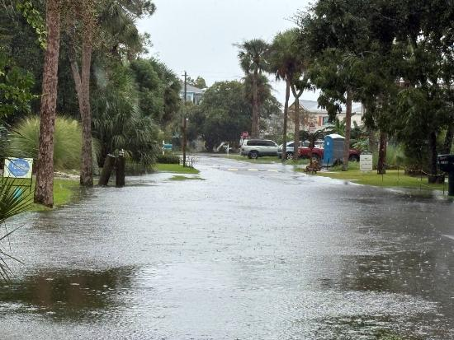
Historic Rainfall This Year
YTD 2025: 54.4 inches
YTD Avg.: 27.23 inches
August 2025: 23.2 inches
August Avg.: 5.7 inches

Slide 3
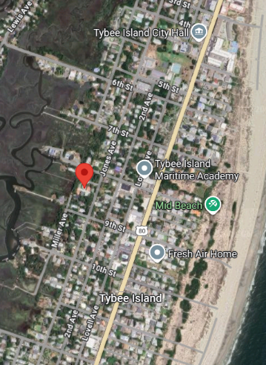
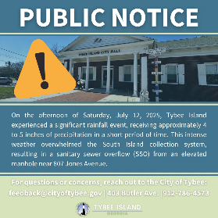
July 12, 2025
4.35 inches of rain
2.1 million gallons processed at Wastewater Treatment Plant
Estimated 10,300 gallons spilled at raised manhole at 807 Jones Avenue

Slide 4
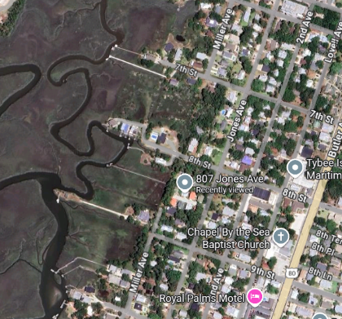
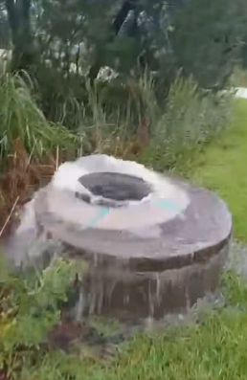
August 9, 2025
5.6 inches of rain
Saturated ground
Extremely high water table
3.9 million gallons processed at Wastewater Treatment Plant Aug. 10
3.5M on Aug. 11
Estimated 24,000 gallons spilled at raised manholes at 807 Jones Ave. and 8th Street over 2-hour period

Slide 5
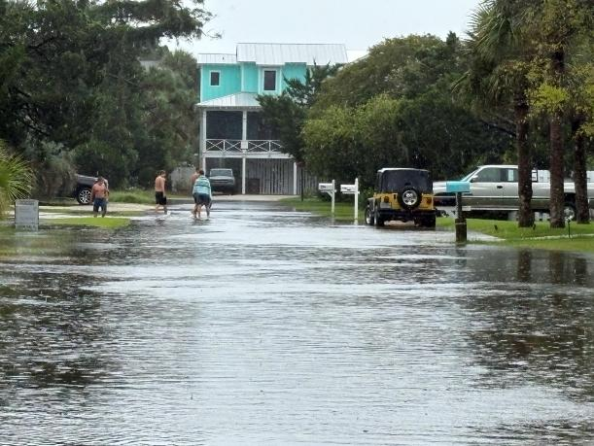
August 23, 2025
5.4 inches of rain
Saturated ground
Extremely high water table
3.52 million gallons processed at Wastewater Treatment Plant Aug. 24
3.48M on Aug. 25
Estimated 40,000 gallons spilled into Horse Pen Creek

Slide 6
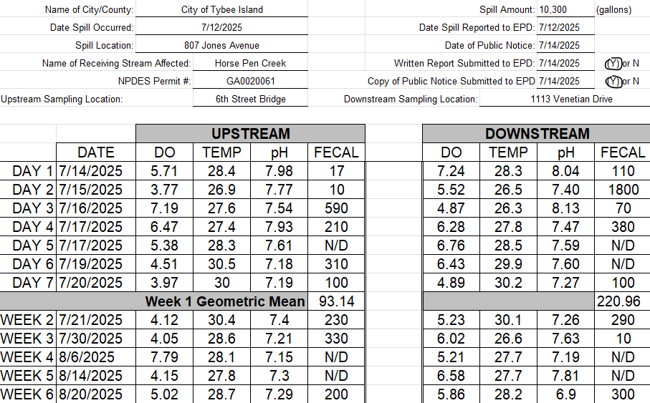
Immediate Actions
Took manual control of Tybee’s south end lift stations in an attempt to slow the massive in-flows by re-distributing through the network
Increased treatment capacity at Wastewater Treatment Plant to make room for incoming flow
All pumps at all lift stations engaged
Sandbagged/spread lime at spill site
Vacuumed spill at location
Notified public through news release and social media
Notified Georgia Environmental Protection Division
Initiated year-long testing protocol
Staff worked 16-hour days to bring spilsl under control

Slide 7
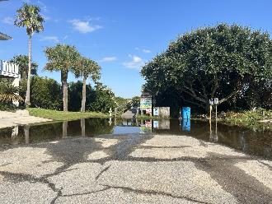
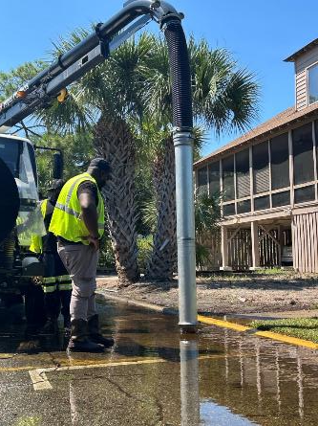
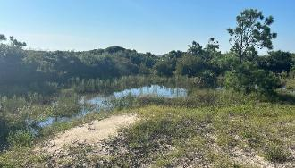
Problem 1: Stormwater
Actions:
Responded to various sink holes across the island, repaired the defects that led to the depressions, and backfilled with gravel and dirt.
Cleared all outlets
Vacuumed water in areas of drainage backup against dune system
Utilized pumps to remove water from areas that would not drain
Expedited permitting for drainage solutions on private property: sump pumps, inlets, etc.

Slide 8
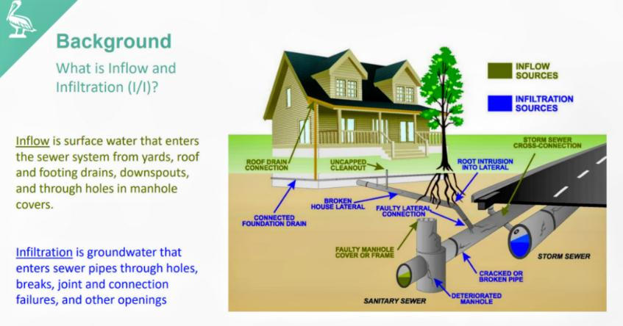
Problem 2: Inflow and Infiltration

Slide 9
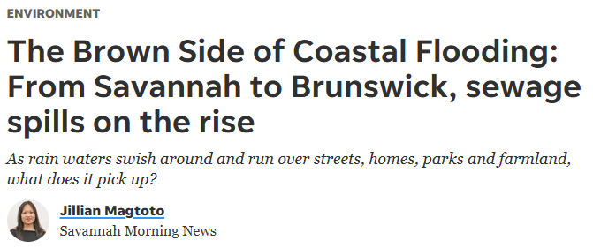
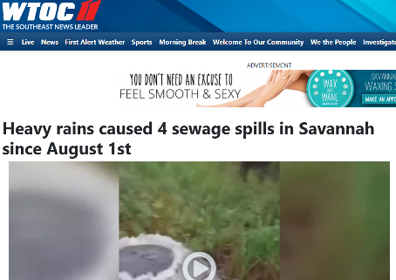
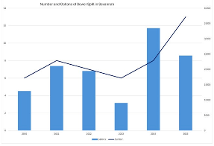
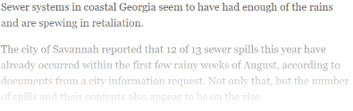
Problem 2: Inflow and Infiltration

Slide 10
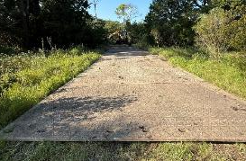
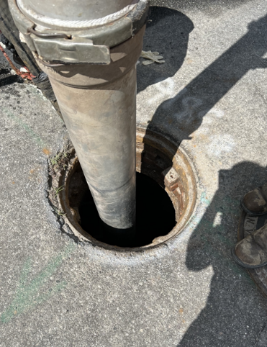
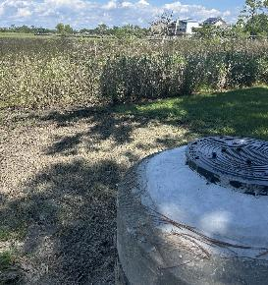
Problem 2: Inflow and Infiltration
Actions:
Raised the height of sanitary sewer manhole in unopened Miller Avenue by 4 feet.
Replaced manhole covers and sealed joints with hydraulic cement
Contracted with company to install waterproof lining on raised manholes
Contracted with sewer jetting company PKX to clean sanitary sewer lines and televise lines looking for structural defects:
Unopened Miller Avenue from 8th Street to 7th Street (18-inch Interceptor)
Miller Avenue from 7th Street to 2nd Street (18-inch Interceptor)
2nd Avenue from Miller Avenue to Jones Avenue (18-inch Interceptor)
Jones Avenue from 2nd Street to Lift Station #6 (18-inch Interceptor)
Jones Avenue from 3rd Street to 2nd Street (Local Sewer)
Chatham Avenue from 15th Street to 17th Street
17th Street from Chatham Avenue to Lift Station #2
17th Street to Butler Avenue to 2nd Avenue
Inlet Avenue from 17th Street to Chatham Avenue
Jones Avenue from 15th Street to Tybrisa Street
Miller Avenue from 15th Street to Tybrisa Street
Chatham Avenue from 17th Street to 19th Street

Slide 11
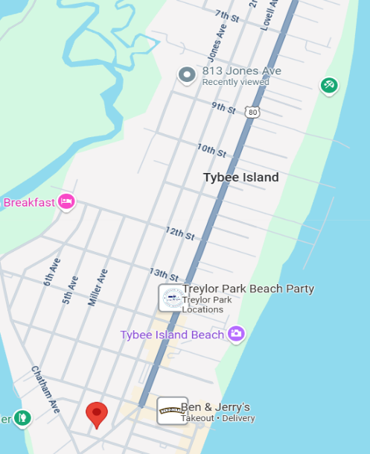
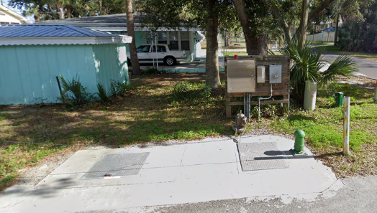
Areas of Current Focus
Miller Avenue 18-inch Interceptor
Jones Avenue 18-inch Interceptor
Lift Station #2 at 2nd Ave and 17th

Slide 12
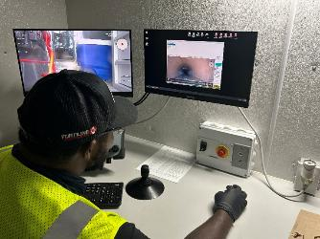
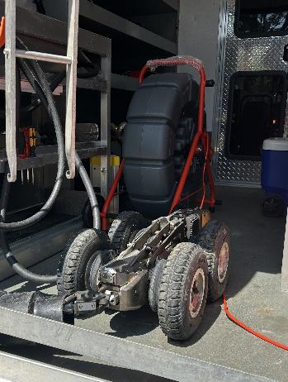
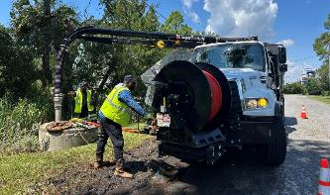
Problem 2: Inflow and Infiltration
Actions:
Lift station 2 and 3 inspected and cleaned.
Began review of line video to develop rehabilitation plan for areas of infiltration.
Public Infrastructure
Private laterals
Held meeting with GEFA loan officer to discuss reallocating infrastructure loan
Created environmental impact plan to keep staff safe during dangerous storm conditions.

Slide 13
Utility Capital Investments Since 2019
YEAR | SEWER | WATER | TOTAL
2019 | $278,568 | $58,367 | $336,935
2020 | $160,245 | $224,212 | $384,457
2021 | $884,788 | $212,923 | $1,097,711
2022 | $1,945,862 | $362,841 | $2,308,703
2023 | $1,086,922 | $687,929 | $1,774,852
2024 | $1,623,532 | $570,658 | $2,194,190
TOTAL | $5,979,919 | $2,116,932 | $8,096,852

Slide 14
Upcoming Investments
$3,250,000 grant-funded project to upsize storm line and outfall beneath 15th Street
Engineering near completion
January project start anticipated
$2,500,000 GEFA loan secured in July for FY26 sewer line replacements
$700,000 grant-funded project under way to design/permit projects to protect backside of Tybee from flooding
$12,500,000 5-year CIP created for water and sewer improvements
$10,000,000 FEMA grant application under review for 14th Street underground reservoir
$4,300,000 in stormwater/resiliency projects included in November SPLOST Referendum

Slide 15
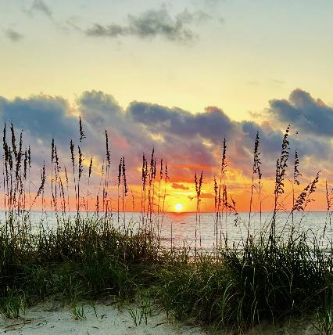
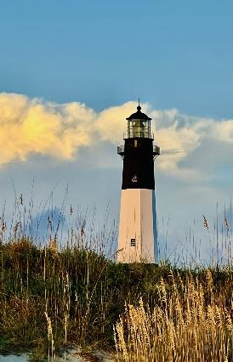
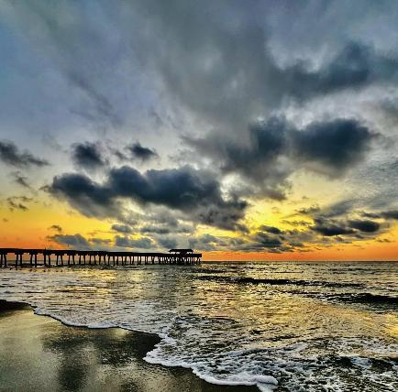
Thank you for your Patience

